Slide 1

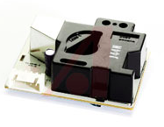
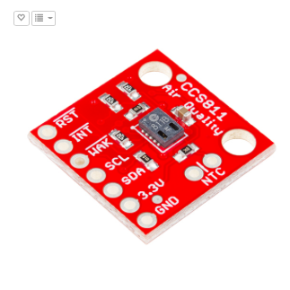

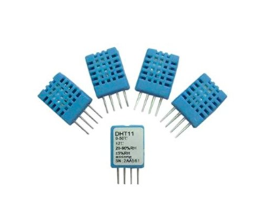


Data Visualization
Goal: Effectively convey IAQ data to the user
disk memory access
Server / DB
hard drive on PC
Python ListenAndProcess.py
hard drive on PC
JQuery
HTML/ JS
Python
ListenAndSend.py
hard drive on PC
PM
USB
VOC
CO₂
Arduino
SendData.ino
disk on Arduino
Motivation
Mapping
Implementation
Review

Slide 2
The Problem
Confusing metrics, uncertain effects, apathy
disk memory access
Server / DB
hard drive on PC
Python ListenAndProcess.py
hard drive on PC
JQuery
HTML/ JS
PM?
?
?
Python
ListenAndSend.py
hard drive on PC
Volatile what?
?
PM
USB
VOC
CO₂
Arduino
SendData.ino
disk on Arduino
Should I be worried?
?
?
Motivation
Mapping
Implementation
Review

Slide 3
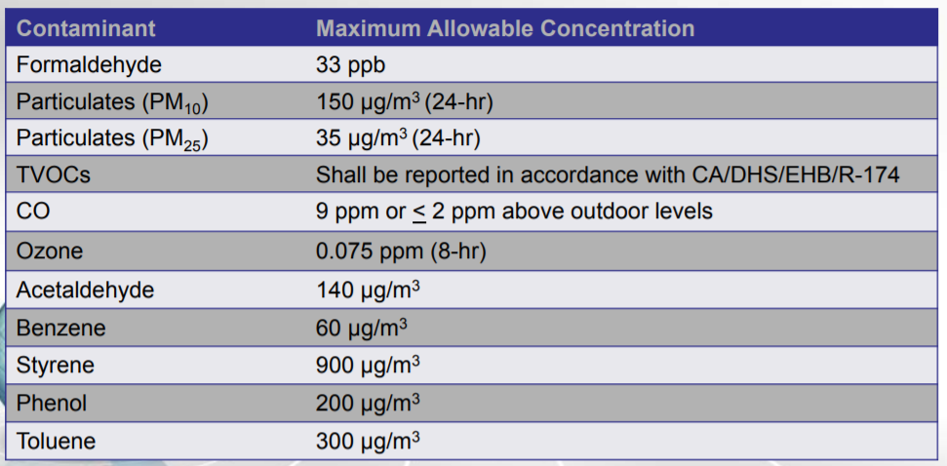

Recap - The System Then
Standard and performance based criteria
Aggregation of data
Statistical summary
Recommendation engine
Cumulative exposure, real time plotting
IAQ heat map
Motivation
Mapping
Implementation
Review

Slide 4
Recap - The System Then
Building facts (use input)
Function for expected effect size.
Select optimal strategies.
Potential Strategies
Turn on fans
Modify HVAC schedule
Change finishes
Cross ventilation
Air filtration
Avoid pollutant generating activities
…. or allow users to test how effective their own strategies are
Outdoor air quality (from other sensors)
Recommendation displayed on web app
Motivation
Mapping
Implementation
Review

Slide 5
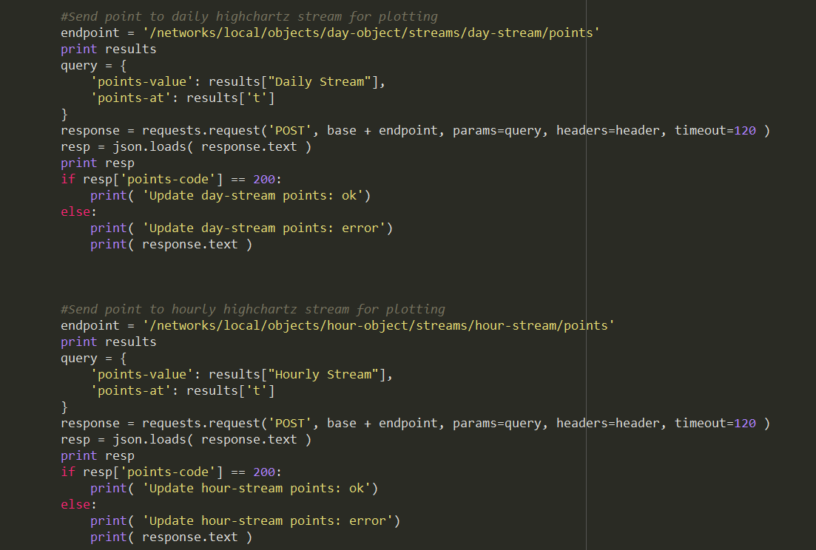
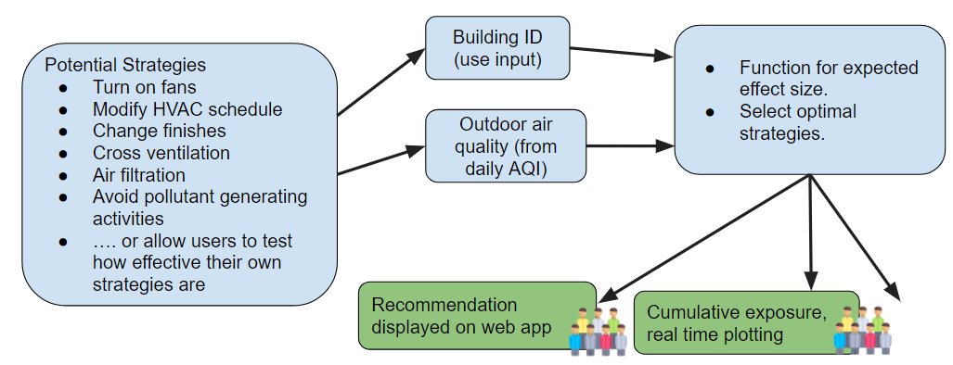
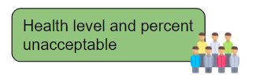
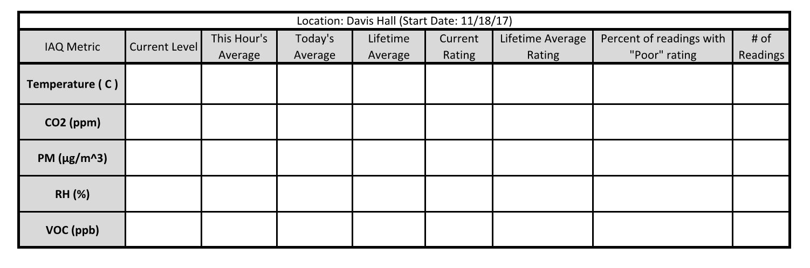
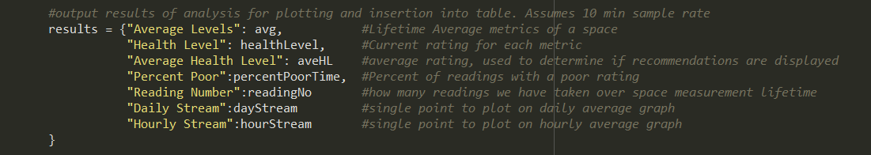
The System Now
Established metrics and methods to convey IAQ to user
Standard and performance based criteria
Motivation
Mapping
Implementation
Review

Slide 6
Processing Output
Metrics for health
Motivation
Mapping
Implementation
Review

Slide 7
Analysis Table
Using bootstrap table for analysis results, more static values and averages
Motivation
Mapping
Implementation
Review

Slide 8
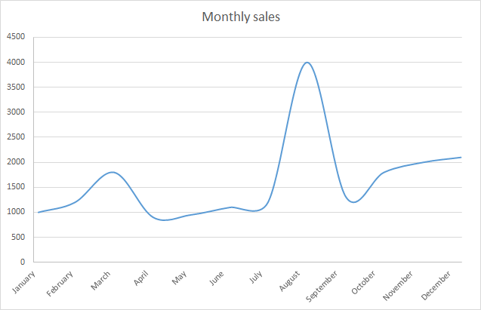
Highcharts
Display 10 minute, hourly, and daily averages in plots
5 Metrics to display
3 timescales
Currently designed for hardwired connection.
Data collection on campus spaces throughout the next week.
Motivation
Mapping
Implementation
Review

